Slide 1







Divisibility tests for 6 and 9
Task A: Divisibility test for multiples of 6
Circle the numbers from each list that are divisible by 6.
389 232 890 382 348 997
8992 9374 380 000 34 830
4 44 444 4444 444 444
2) Four students play a computer game. The game has 200 levels. Every time a student moves onto the next level they score 6 points.
I have 918 points
I have 1114 points
Lucas
Jacob
I have 1195 points
I have 1194 points
Sam
Who is telling the truth?
Justify your answer for each person.
Sofia
‹#›

Slide 2
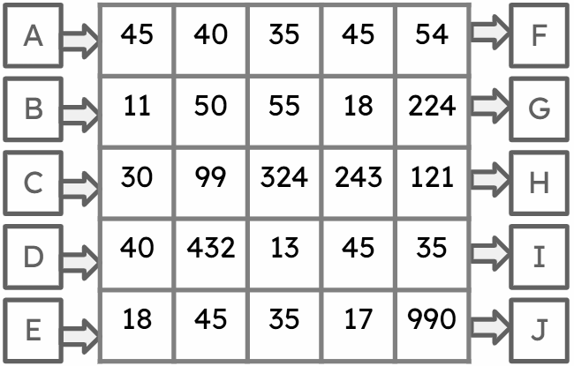
Divisibility tests for 6 and 9
Task B: Divisibility test for multiples of 9
1) You need to enter a maze through entrance A, B, C, D or E. You are only allowed to step on numbers that are multiples of 9. You can only step vertically or horizontally. You must exit through either F, G, H, I or J.
a) What entrance do you use?
b) Draw your path.
c) What exit do you use?
2) Using the numbers below, fill in the Venn diagram.
849
32 377
7 498 342
22
8676
222 222 222
9090
984
117
7931
Multiples of 6
Multiples of 9
Mathematics in Education and Industry
‹#›
‹#›
v2.1

